Slide 1
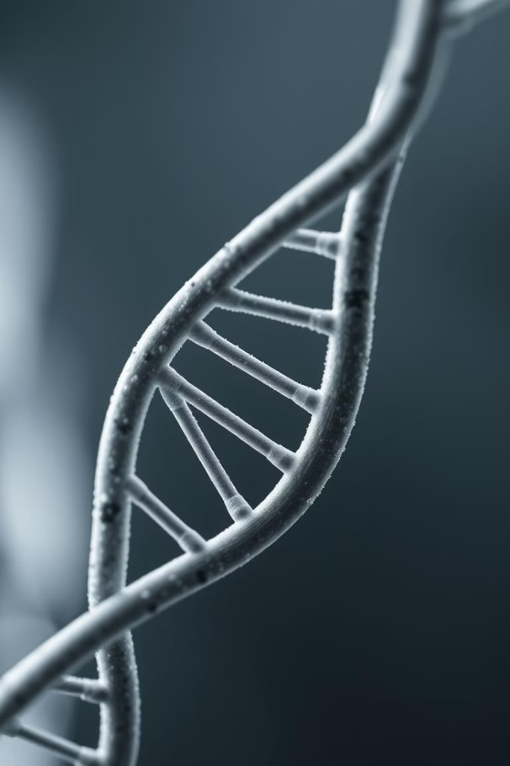

TRINITY
COLLEGE OF ENGINEERING & TECHNOLOGY
Prediction of Identical Twins using Machine Learning
Presented By
Sai Teja (22UD5A7301)
Charan (22UD5A7305)
Taheer (22UD5A7306)

Slide 2

Abstract
The "Prediction of Identical Twins using ML" project seeks to develop a machine learning-based solution for accurately identifying identical twins from a population based on their physical characteristics and biometric data. Identifying identical twins is a complex task with significant implications in various fields, including healthcare, forensics, and even personalized marketing. Leveraging machine learning, this project aims to advance the state-of-the-art in twin identification, offering a novel and efficient approach to a longstanding challenge.

Slide 3
Introduction
Identical twins, also known as monozygotic twins, share 100% of their genetic material and often bear a striking physical resemblance to each other. Despite their genetic similarity, there is a lack of automated and accurate methods to identify identical twins based on their unique physical characteristics. Existing identification methods rely on subjective observations or biometric data, such as fingerprinting or facial recognition, which can yield unreliable results. This project aims to tackle this issue by harnessing the power of machine learning to create a more reliable and objective means of identifying identical twins.

Slide 4
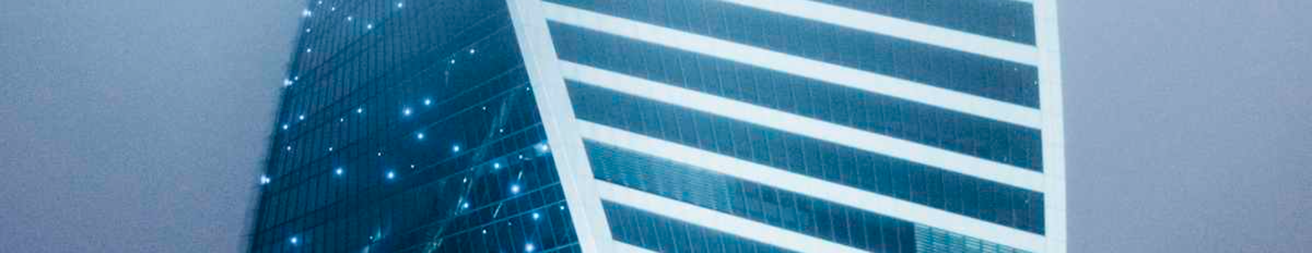
Motivation
1
Forensic Investigations
2
Organ Transplants
3
Genetic Research
Accurate twin identification is critical in criminal investigations, particularly when DNA evidence alone cannot distinguish between suspects.
Misidentifications can have serious consequences in organ transplant procedures, where compatibility between donor and recipient is paramount.
Twin studies are invaluable for understanding genetic and environmental influences on human traits. Accurate identification is essential for drawing reliable conclusions.

Slide 5

Limitations of Current Systems
Subjective Observations
Biometric Limitations
Current methods often rely on subjective observations of physical traits like facial features, hair color, and body build.
Biometric methods like fingerprinting and facial recognition can be prone to errors and are not always reliable in distinguishing identical twins.
Misidentification Risks
Misidentifications can have significant consequences in forensic investigations, healthcare, and research, leading to incorrect conclusions and legal repercussions.

Slide 6




ML-based Twin Prediction System
Retina Scans
Facial Recognition
The system analyzes high-resolution retina scans for unique patterns and variations that may distinguish between twins.
Advanced facial recognition algorithms are employed to identify subtle differences in facial features, such as bone structure and skin texture.
Brainwave Analysis
The system incorporates brainwave analysis, which can detect subtle variations in neural activity that may be unique to each twin.

Slide 7

Feasibility Study
1
Economic Feasibility
The system utilizes open-source technologies and readily available hardware, making it cost-effective to develop and deploy.
2
Technical Feasibility
The system has modest resource requirements and can be easily integrated into existing healthcare or forensic databases.
3
Social Feasibility
The system has the potential to enhance user confidence and acceptance by providing more accurate and reliable identification results.

Slide 8
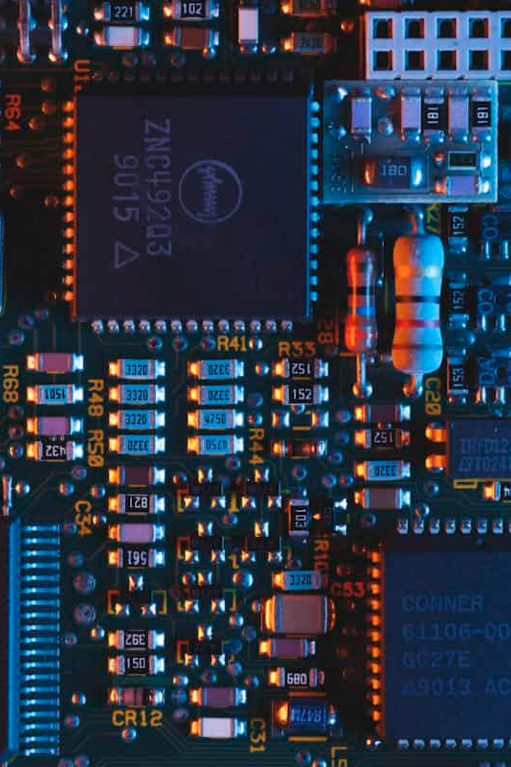

System Requirements
Hardware Requirements
This project requires a standard computer with the following Hardware.
Processor: Pentium IV or above
RAM: 4 GB or above
Hard Disk: 20 GB
Peripherals: Keyboard, mouse, monitor

Slide 9
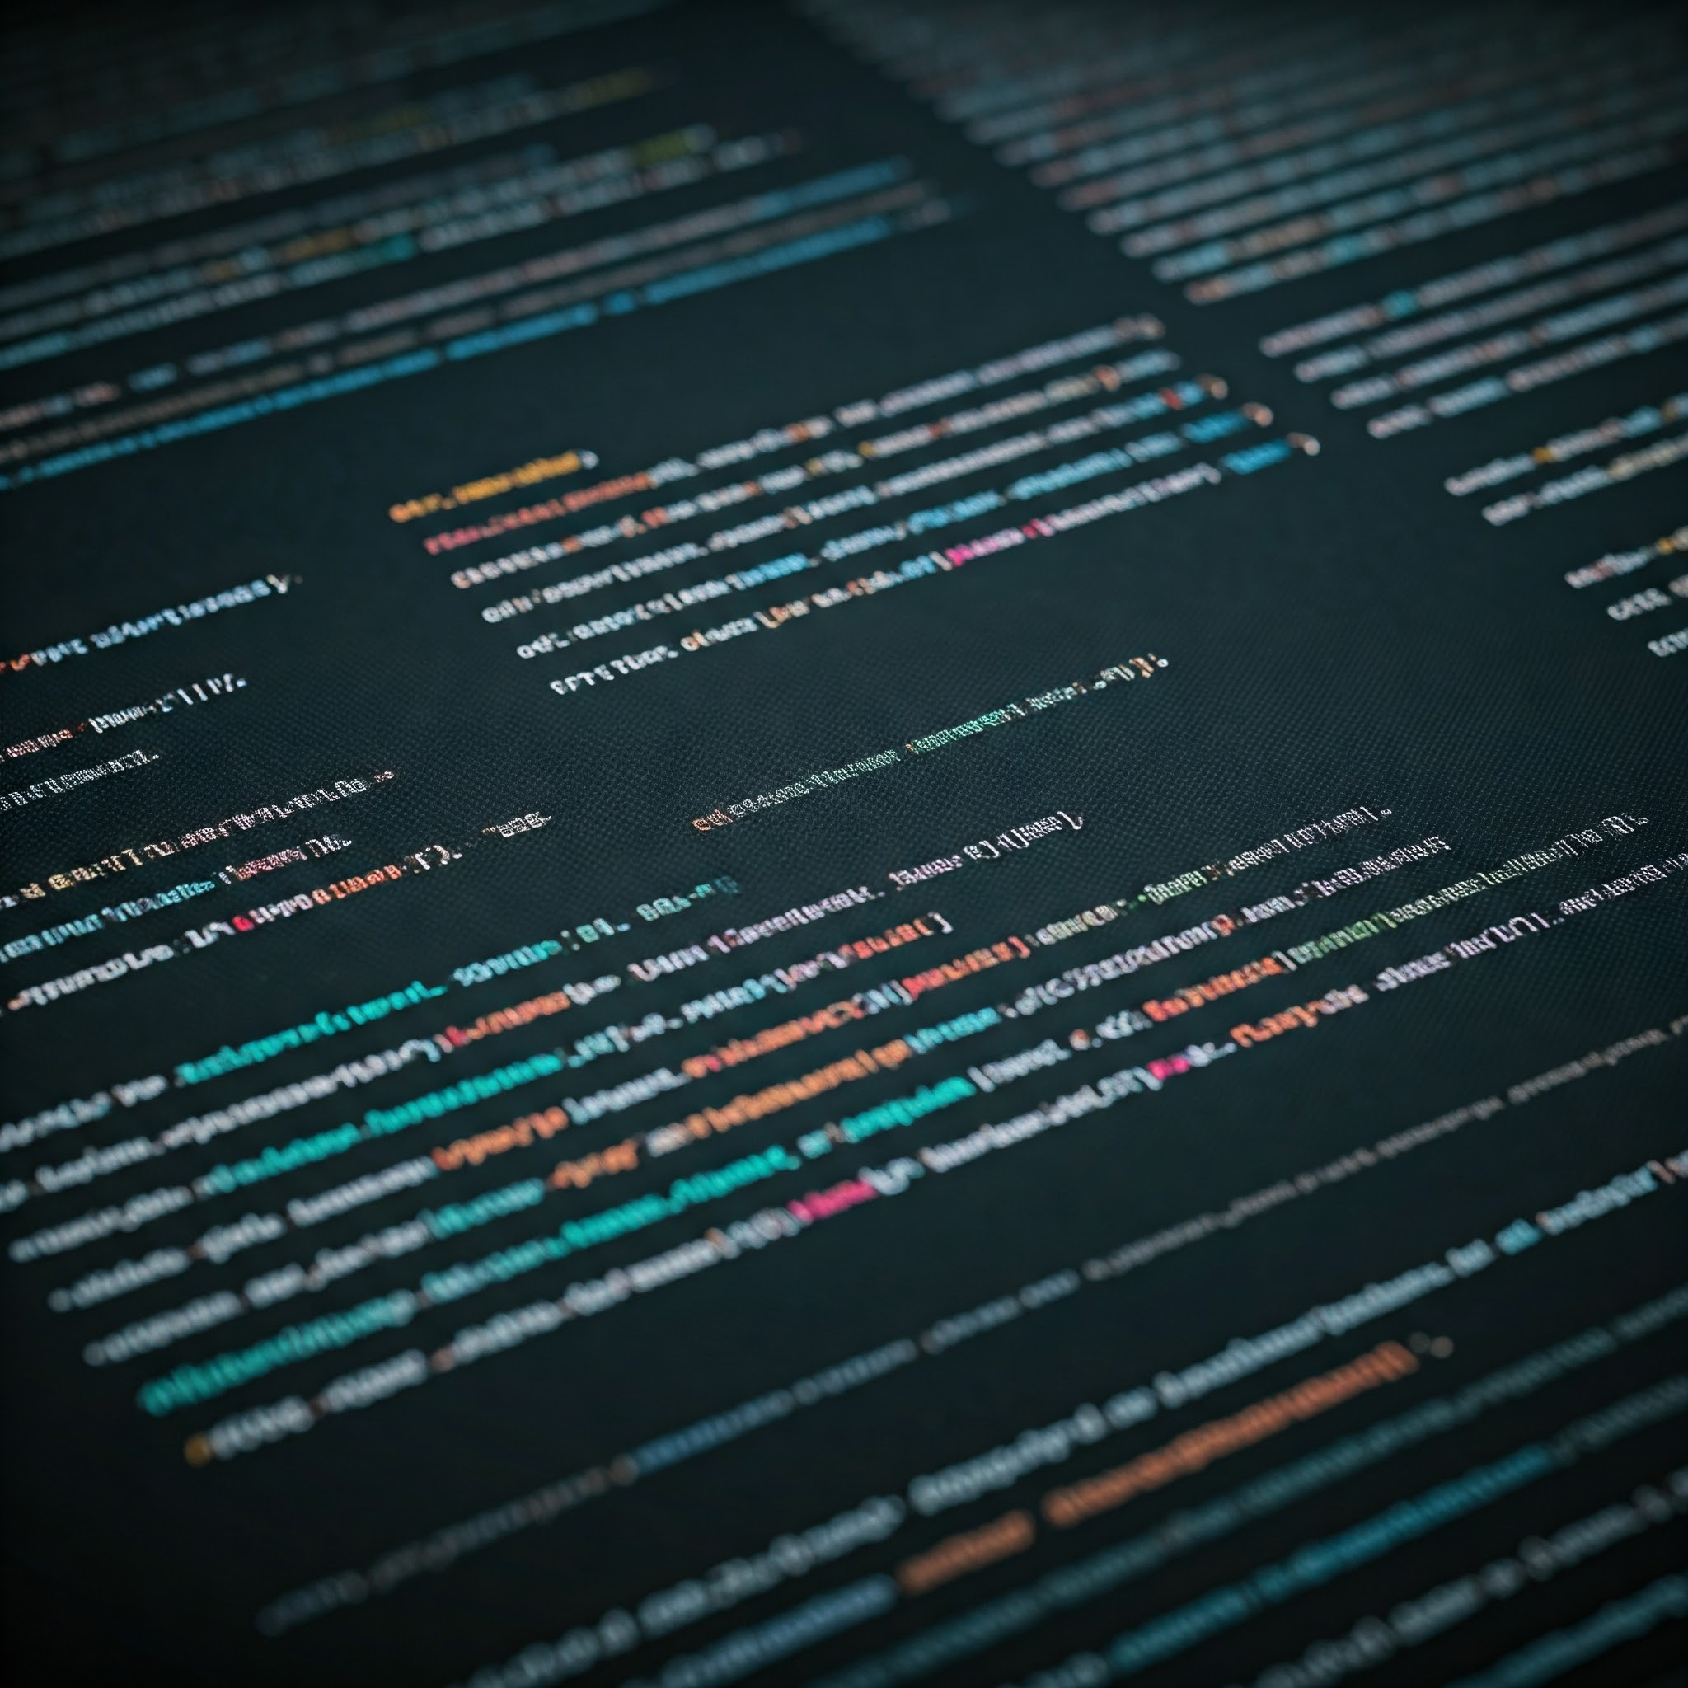
System Requirements
Software Requirements
This project requires a standard computer with the following Software and OS.
Operating System: Windows 8 or above
Programming Language: Python
Libraries: TensorFlow, Numpy, Matplotlib, Scikit-learn
2

Slide 10



System Modules
User Module
1
The User Module provides a user-friendly interface for uploading retina and face images.
System Module
2
The System Module performs various tasks, including image preprocessing, algorithm execution, and prediction generation.
Prediction Module
3
The Prediction Module displays the prediction results, indicating whether the individuals are identical twins or not.

Slide 11
System Design
Use Case Diagram
1
Illustrates the interactions between the user and the system, highlighting the different functionalities available to the user.
Class Diagram
2
Depicts the system's structure and relationships between different classes, representing the different components and their interactions.
Sequence Diagram
3
Shows the workflow of the system, starting with the user uploading images and ending with the system generating a prediction.

Slide 12
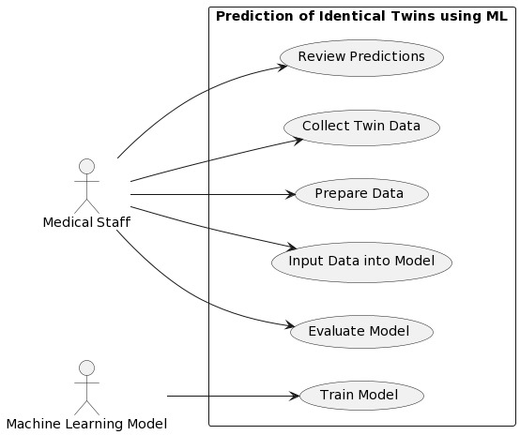
System Design
Use Case Diagram:
Illustrates the interactions between the user and the system, highlighting the different functionalities available to the user.

Slide 13
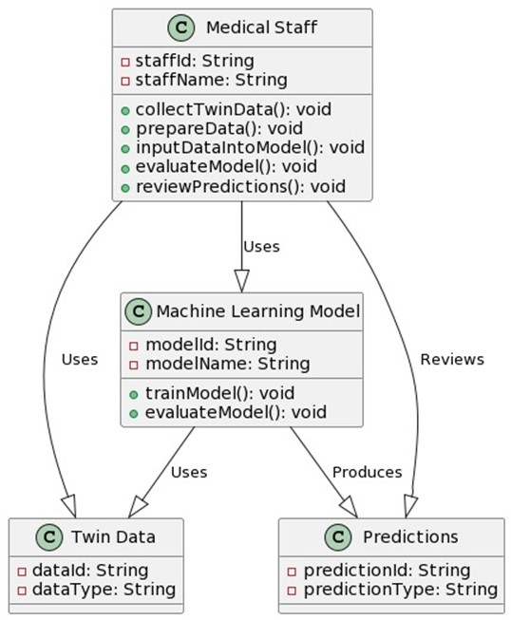
System Design
Class Diagram:
Depicts the system's structure and relationships between different classes, representing the different components and their interactions

Slide 14
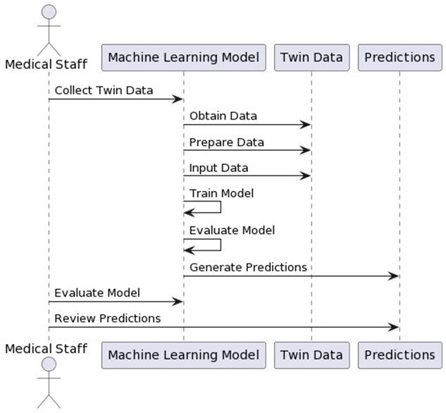
System Design
Sequence Diagram:
Shows the workflow of the system, starting with the user uploading images and ending with the system generating a prediction.

Slide 15
Training Process
Dataset Upload
Model Training
Upload and pre-process a dataset of twin and non-twin face images. The images are normalized and resized for optimal training.
Naïve Bayes and Random Forest classifiers are trained on the pre-processed dataset, optimizing parameters for accuracy and efficiency.

Slide 16
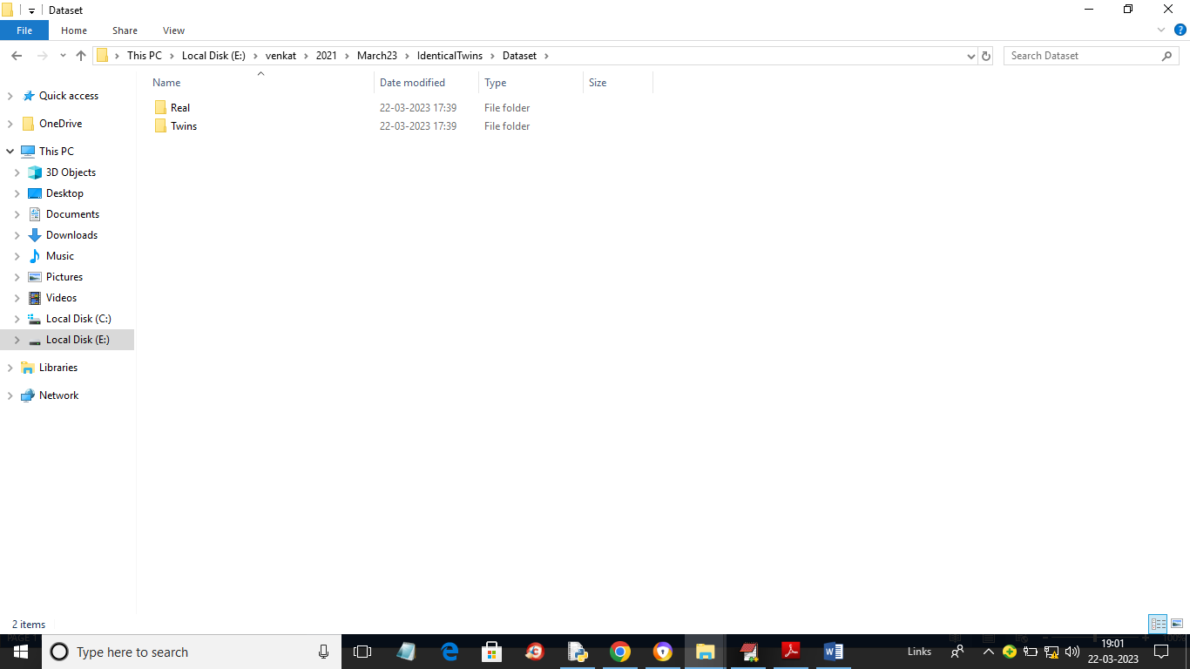
Training Process
For training we are using below images dataset

Slide 17
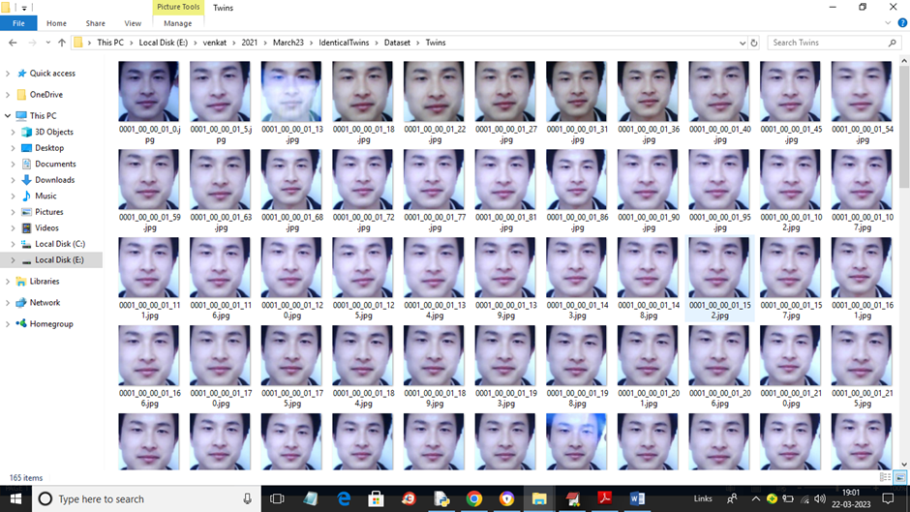
Training Process
This is the twin images dataset we are using.

Slide 18
Training Process
Upload Twins Dataset: using this module we will upload dataset to application and then apply filtration and object detection techniques
Dataset Preprocessing: using this module we will normalized and then shuffle and split dataset into train and test where application using 80% dataset for training and 20% for testing
Run Naive Bayes Algorithm: 80% processed train images will be input to Naive Bayes Algorithm to train a model and this model will be applied on 20% test images to calculate prediction accuracy
Run Random Forest Algorithm: 80% processed train images will be input to Random Forest Algorithm to train a model and this model will be applied on 20% test images to calculate prediction accuracy
Comparison Graph: using this module we will plot comparison graph between both algorithms
Twins or Real Face Prediction: using this module we will upload test images and then algorithm will predict weather image is real or belongs to twins

Slide 19
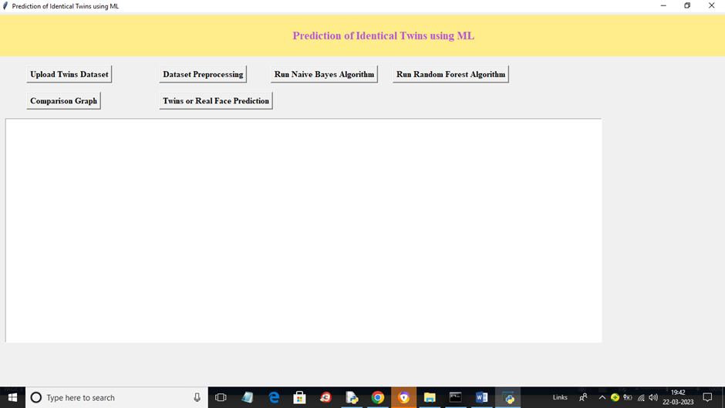
Training Process
To run project double click on ‘run.bat’ file to get below screen

Slide 20
Training Process
In previous screen click on ‘Upload Twins Dataset’ button to upload dataset and get below output

Slide 21
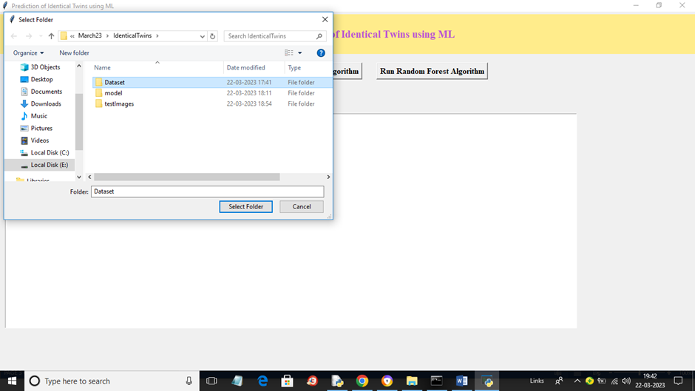
In below screen selecting and uploading ‘Dataset’ folder and then click on ‘Select Folder’ button to load dataset

Slide 22
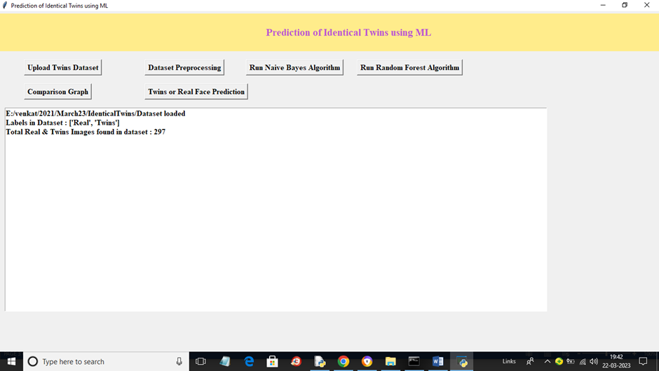
After selection Dataset you will see the below output

Slide 23
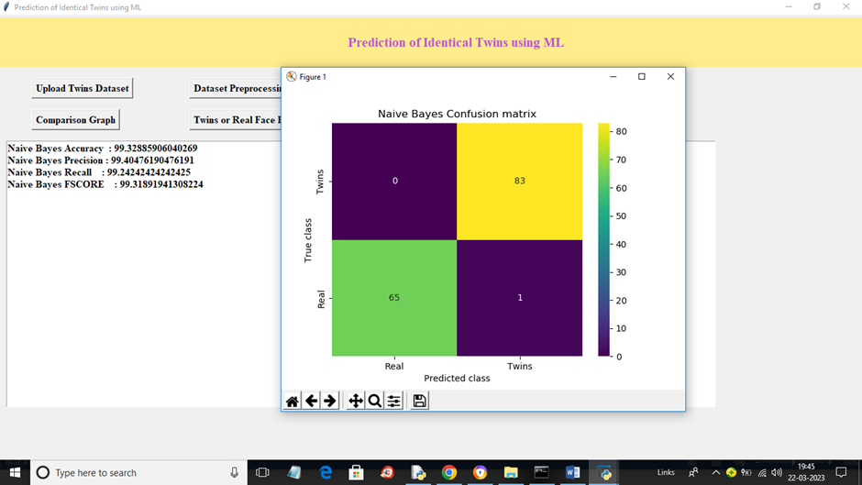
Now click on ‘Run Naïve Bayes Algorithm’ button to train Naïve Bayes and get below output

Slide 24
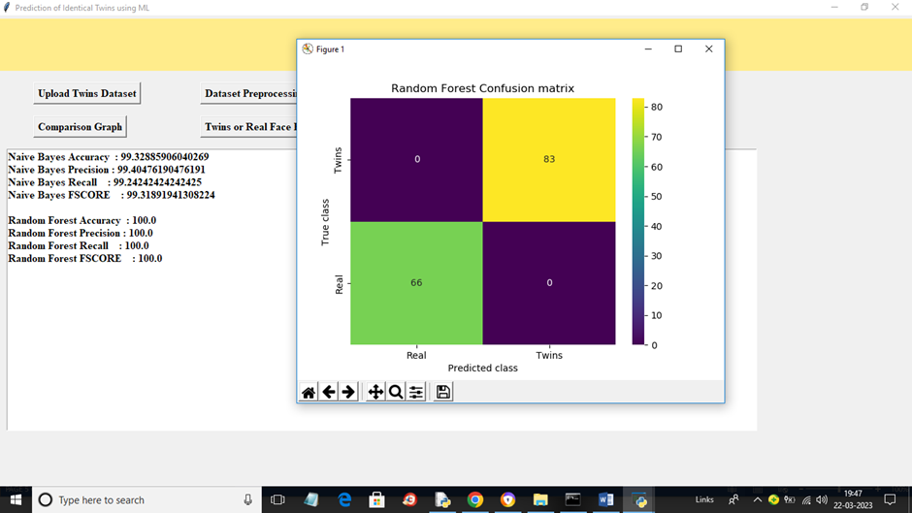
Now close above window and then click on ‘Run Random Forest’ button to train Random Forest and get below output.

Slide 25
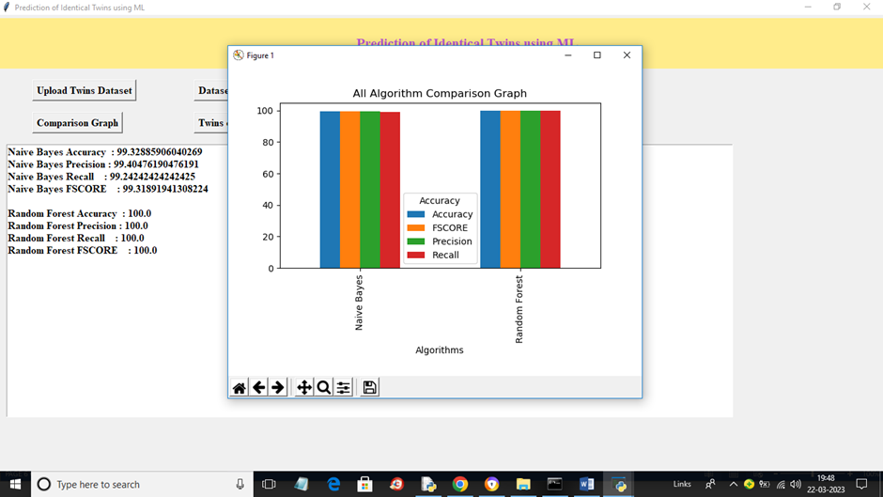
We can see confusion graph also and now click on ‘Comparison Graph’ button to get below graph.

Slide 26
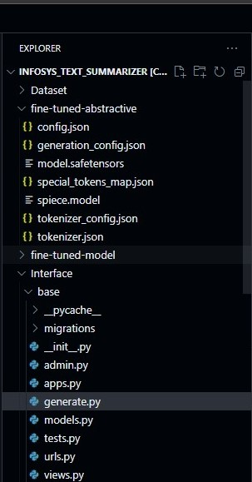
Prediction Results
Real Twins
Twin Simulation
The system accurately identifies pairs of real twins, recognizing subtle differences in facial features.
To test the system's robustness, simulations were used to generate pairs of near-identical faces, and the system successfully distinguished them.

Slide 27
Testing and Evaluation
Unit Testing
Integration Testing
Each module, including image pre-processing and prediction, is rigorously tested to ensure accuracy and efficiency.
The entire system is tested as a whole to ensure that the modules work seamlessly together and produce accurate results.

Slide 28
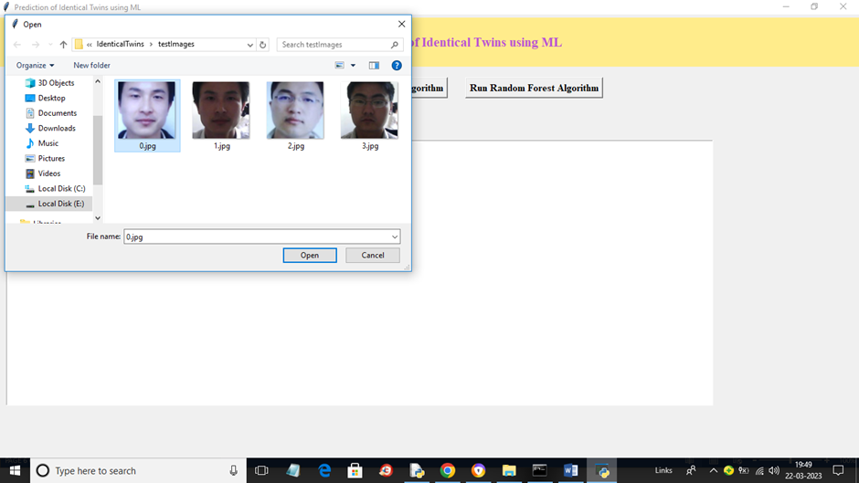
Now click on ‘Twins or Real Face Prediction’ button to upload test image and get below output.

Slide 29
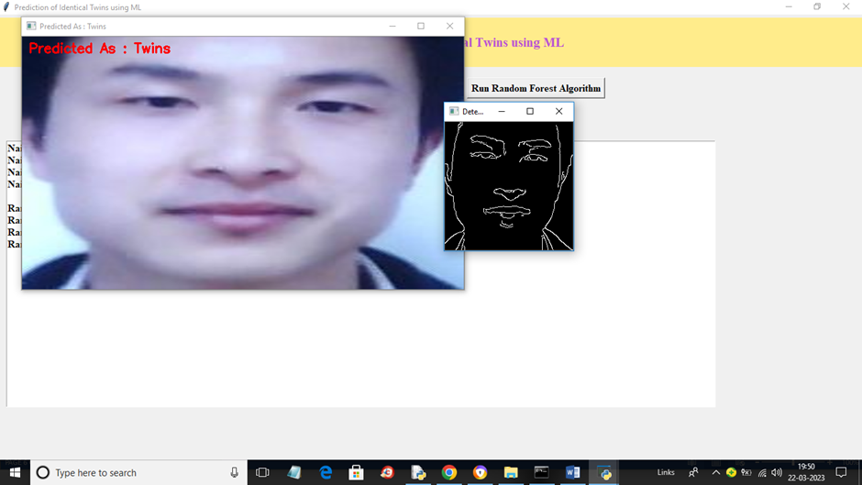
In Prev screen selecting and uploading ‘0.jpg’ image and then click on ‘Open’ button to load image and get below output.

Slide 30
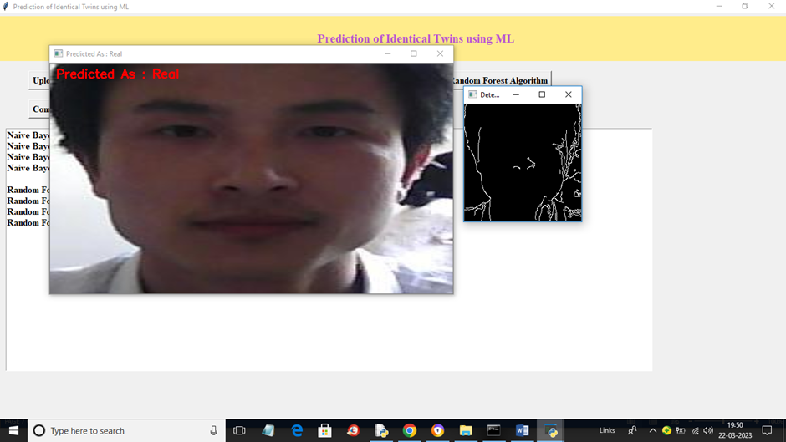
In below screen image predicted as real.

Slide 31



Future Enhancements
Dataset Expansion
1
Expanding the dataset with a wider diversity of populations will improve model robustness and generalizability.
Advanced Algorithms
2
Exploring more sophisticated algorithms, such as convolutional neural networks, may further enhance accuracy and performance.
Real-time Integration
3
Integrating the system with real-time applications like forensics or security systems could have significant practical implications.

Slide 32
Conclusion
Utilized Naive Bayes And Random Forest Algorithms for Accurate Prediction.
Achieved High Accuracy (99% with Naïve Bayes and 100% with Random Forest)
With Further Advancements, it can become a vital tool in various domains

Slide 33
Thank You

